Slide 1
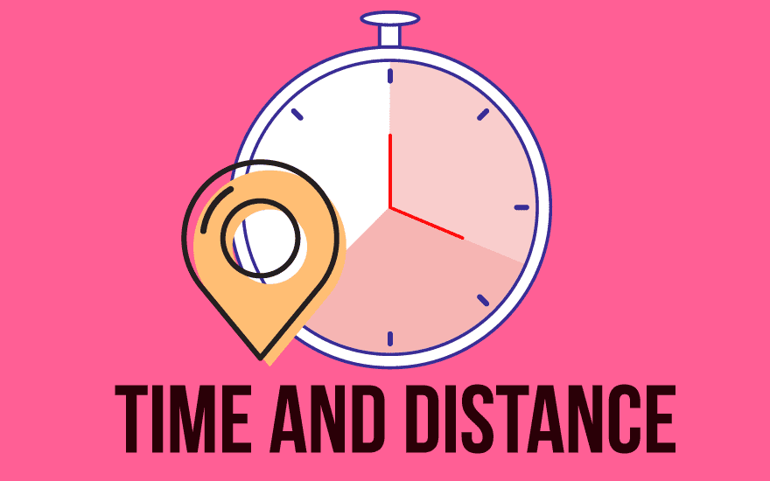
pea 516
Lecture-7
Time and distance

Slide 2
Contents:
Average speed
Variable speeds

Slide 3

AVERAGE SPEED
What is the Average Speed Formula?
The average speed of a body is equal to the total distance covered, divided by the total time taken. The average speed formula is expressed as follows:
Average Speed Formula

Slide 4
1) A man covers 30 km distance with speed of 10 kmph and return with 15 kmph. Find average speed.
6 kmph
12 kmph
12.5 kmph
12.25 kmph

Slide 5
Example: During a journey, a train moves at a speed of 50 kilometers per hour for the first 2 hours and 70 kilometers per hour for the next 3 hours. Find the average speed of the train using the average speed formula.

Slide 6
2) A man covers 60 km distance with speed of 10, 12 and 15 kmph on three successive days. Find average speed.
6kmph
12 kmph
12.5 kmph
12.25 kmph

Slide 7
Example: A train is moving with a speed of 80 miles per hour for the first 4 hours and 110 miles per hour for the next 3 hours. Find the average speed of the train with the help of the average speed formula.
Notes:
Ans: 92.86 miles/hour

Slide 8



When the distance is constant:
Two speeds S₁ and S₂ are given
Average speed =
Two speeds S₁,S₂ and S₃ are given
Average speed =
Case 2 – When the time taken is constant:
Average speed = (x + y)/2;

Slide 9
Example: If the car had gone from A to B at 50 kmph and returned from B to A at 60 kmph, what would be the average speed?

Slide 10
3) A man covers a certain distance by car driving at 30kmph and he returns back to the starting point with a speed 40kmph. Find his average speed for the whole journey.
35 km/hr
34.3 km/hr
36 km/hr
None

Slide 11
4) A man travels the first part of his journey at 30 kmph and the remaining part at 90 kmph, and he covers the entire journey at an average speed of 50 kmph. What is the ratio of the distance he covered at 30 kmph to that he covered at 90 kmph?
1 : 2
1 : 3
2 : 3
3 : 4

Slide 12
5) A boy goes to school with speed of 3 kmph and return with 2 kmph. If he takes 5 hrs in all. Find distance between home and school.
5 km
6 km
10 km
12 km

Slide 13
6) A boy goes to school with speed of 6 kmph and return with 3 kmph. If he takes 5 hrs in all. Find distance between home and school.
5 km
6 km
10 km
12 km

Slide 14
Example: A man covers a certain distance between his house and office on bike. Having an average speed of 30 km/hr, he is late by 10 minutes. However, with a speed of 40 km/hr, he reaches his office 5 minutes earlier. Find the distance between his house and office?

Slide 15
7) A boy walk at 5 kmph and reaches his school 10 min late. If speed has been 6 kmph, he will reach 15 min early. Find distance between home and school.
6.25 km
12 km
12.5 km
25 km

Slide 16
8) If train runs at 40 kmph, it reaches its destination late by 11 min but if it runs at 50 kmph, it is late by 5 min. Find the correct time for train to complete the journey.
11 min
19 min
24 min
30 min

Slide 17
9) Walking at 4 km/h a clerk reaches his office 5 min late. If he walk at 5 km/h he reaches 2 and half min earlier. What's the distance?
15 km
10 km
25 km
2.5 km

Slide 18
10) Walking 5/6 of usual speed a man is late by 10 min. Find the usual time taken by him to cover the distance.
50 min
60 min
40 min
30 min

Slide 19
11) Krishna covers a certain distance by train at 25 kmph and same distance by foot at 4 kmph. If the total journey is of 5 hr 48 min. Find total distance covered by him
20 km
40 km
80 km
120 km

Slide 20
12) While driving from Chennai to Bangalore, I covered half of the journey at an average speed of 80 kmph, half of the 2nd half of the journey at an average speed of 40 kmph and the rest at 60kmph. It took 5 hours and 30 minutes to reach Bangalore. How far is Bangalore from Chennai?
310 km
350 km
330 km
360 km

Slide 21
13) A person has to cover a distance of 6 km in 45 minutes. If he covers one-half of the distance in two-thirds of the total time; to cover the remaining distance in the remaining time, what should be his speed in km/hr?
10 km/hr
12 km/hr
15 km/hr
None

Slide 22
14) Excluding stoppages, the speed of a bus is 54 kmph and including stoppages, it is 45 kmph. For how many minutes does the bus stop per minute?
10
20
9
12

Slide 23


